Slide 1

Distillation Learning Tests
20.09.2023
C1
WORKSHOP 2
RISQ/MRM

Slide 2
OUTLINES
INTRODUCTION
Reminder of Knowledge Distillation Fundamentals
Main Use of Knowledge Distillation
Relevant Applications in Scientific Work
Distillation OF pd estimation models
Teacher Training
Hinton-Based Distillation
Adversarial Knowledge Distillation Framework
X-Distillation
DISTILLATION ON LENDING CLUB dataset
Teacher Training – Feed-Forward Neural Networks
Teacher Training – XGBOOST
Student Distillation Training – Feed-Forward Neural Network
References
Appendix

Slide 3
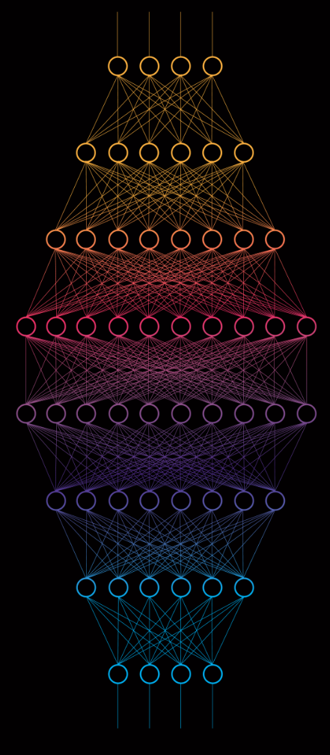
1. INTRODUCTION
A. Reminder of Knowledge Distillation Fundamentals
B. Main Use of Knowledge Distillation
C. Relevant Applications in Scientific Work

Slide 4
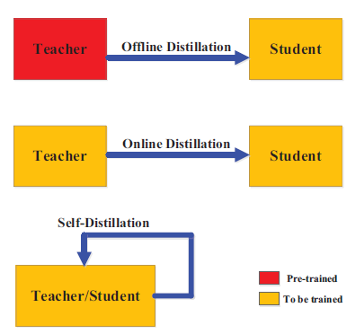
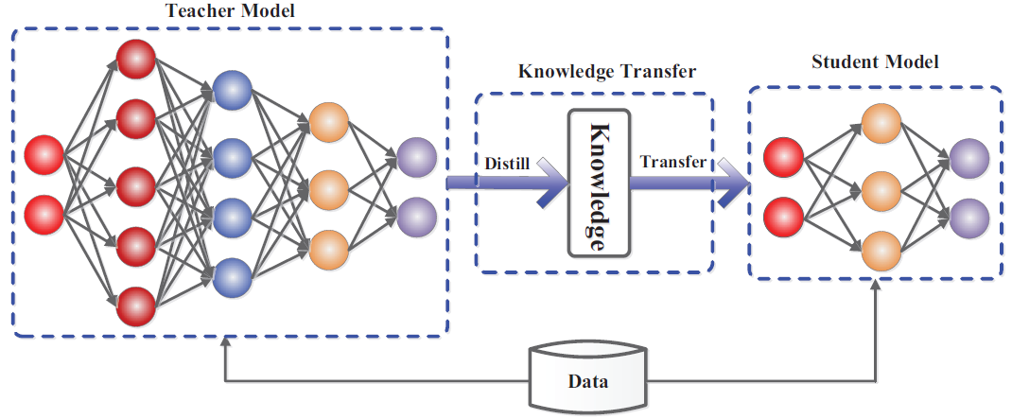
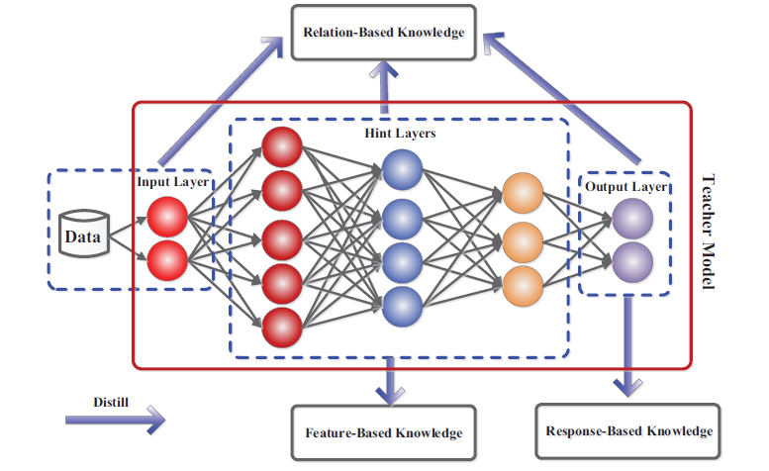
A. Reminder of Knowledge Distillation Fundamentals
Fig. 1 The generic teacher-student framework for knowledge distillation
Fig 3. Different Distillation Training Modes
Fig 2. The schematic illustrations of sources of knowledge in a deep teacher network

Slide 5
B. Main Use of Knowledge Distillation
3 Main Potential Uses of Knowledge Distillation
1
2
3
XAI
If we have an inexplicable teacher such as a deep neural network or a random forest, we can use distillation of the teacher to train an interpretable and transparent model such as a decision tree along with being close to the teacher performance.
Enhancing Performance
A simple model is such as logistic regression, random forest, decision tree, linear regression or a simple neural network.
Reducing Models Complexity
In the context of compression, distillation can be used to reduce models' complexity.
In this case, the trade off performance/interpretability must be balanced depending on the situation.
In MRM context , performance of PD ESTIMATION MODELS can be enhanced by training a complex model such as deep neural network and then distilling it into a student model.
Training a simple model through distillation of a more complex model usually outperforms training directly the same simple model.
Usually, we use the teacher for inference alongside with student’s interpretability insights.
We can also enhance performance of more sophisticated models by using self-distillation and transfer learning frameworks
However, the student cannot outperform the teacher in general due capacity gap.
In result, several frameworks were developed by scholars to reduce the performance gap between the teacher and the student.
Some of the most relevant frameworks are adversarial knowledge distillation, interpretability distillation and transfer learning.

Slide 6
C. Relevant Applications in Scientific Work
Article | Description | Performances | Commentary
Improving the Interpretability of Deep Neural Networks with Knowledge Distillation (Liu, et al., 2018). | Distill Deep Neural Networks (CNN) into decision trees for the MNIST Task. In this work, Application in XAI and model performance enhancing. | Baseline student accuracy: 84% Teacher accuracy: 99.25% Distilled student accuracy: 86.6 % | The choice of an interpretable student always creates a performance gap between the student and the teacher. However, outperforming the baseline is always possible in interpretability applications.
Natural Language Generation for Effective Knowledge Distillation (Tang, et al., 2019) | Distill a BERT (Devlin, et al., 2018) teacher into a smallest BiLSTM using a transfer set constructed by GPT-2 (Radford, et al., 2019) and TXL (Dai, et al., 2019), application in model complexity reduction. | BiLSTM baseline accuracy: 87.6% BERT Teacher accuracy: 94.9% Distilled BiLSTM student on GPT-2 transfer dataset accuracy: 92.7 % | BERT models are very heavy and requires important computational resources for training. Distillation learning reduces complexity while staying faithful to the original performance.
Table 1. Relevant Distillation Learning Applications in Literature

Slide 7
2. Distillation OF PD ESTIMATION MODELS
Teacher Training
Hinton-Based Distillation
Adversarial Knowledge Distillation Framework
Xdistillation Framework

Slide 8
INTRODUCTION TO PD ESTIMATION MODELS FRAMEWORK
PD ESTIMATION MODELS
Stacking
Train
Logistic Regression 1
Module Data 1
Train
Output 1
Module Data 2
Logistic Regression 2
Output 2
Training
All modules Logistic Regression
Final output
PD Prediction
Train
Logistic Regression 3
Output 3
Module Data 3
Train
Output 4
Module Data 4
Logistic Regression 4
Figure 3. PD ESTIMATION MODELS Training Workflow
Modules | AR* Train | AR Test | AR OOT
Module 1 | 55,3% | 53,2% | 60,2%
Module 2 | 53,91% | 52,98% | 57,43%
Module 3 | 64,7% | 64,4% | 66,76%
Module 4 | 28,86% | 28,88% | 32,78%
All Modules | 65,4% | 66,2% | 66,4%
2 TYPES OF TEST DATA ARE USED:
TEST SET : Each obligor (borrower) has data records in different date times.
OUT-OF-TIME SET (OOT): each obligor has one data record at a date fixed in 2018.
Table 2. Performance of PD ESTIMATION MODELS
Our goal is to enhance performance of the overall model on the test and out-of-time sets.
*Accuracy Ratio = 2 * ROC AUC – 1

Slide 9
PD estimation mdoels’ Distillation Framework
The objective of the distillation framework is to enhance the overall PD ESTIMATION MODELS performance.
Module Data 1
Train
Teacher
Module Data 2
Hinton-Based Distillation
Adversarial Knowledge Distillation
XDistillation
Concatenate Modules’ Features
All Features Dataset
One-Hot Encoding
Module Data 3
Student
Module Data 4
Figure 4. PD ESTIMATION MODELS Distillation Framework

Slide 10
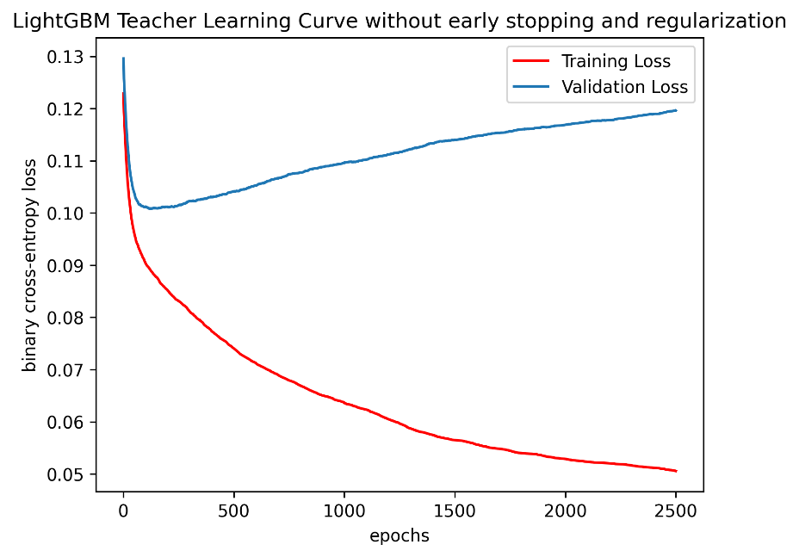
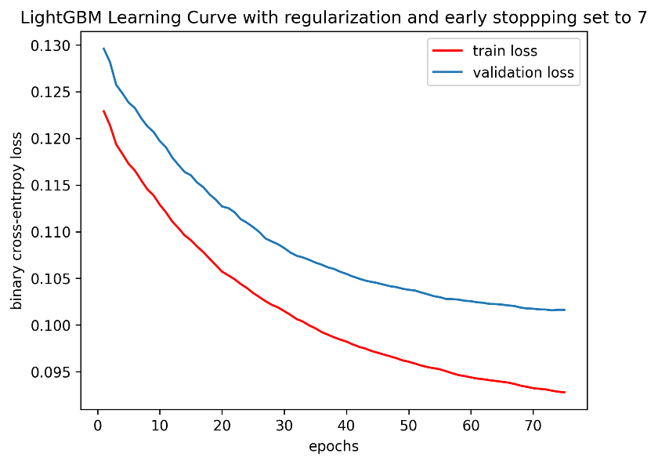
TEACHER TRAINING
Figure 5. LightGBM teacher learning curves without regularization
Figure 6. LightGBM teacher learning curves with regularization (L1 = 0.01 and Early Stopping = 7)
Models | AR TRAIN | AR TEST | AR OOT
PD estimation models | 65,4% | 66,2% | 66,4%
Feed-Forward Neural Networks (FFNN) | 72.28 % | 63.25 % | 71.28 %
LightGBM with regularization | 70.87 % | 67.41 % | 71.44 %
LightGBM without regularization | 89.16 % | 58.55 % | 58.84 %
Selected Teacher
Table 3. Performance of offline trained teachers using all modules’ features

Slide 11
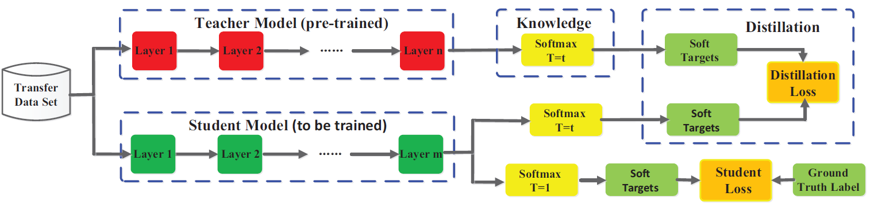
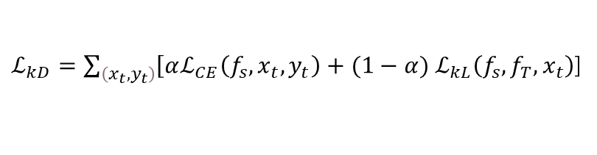
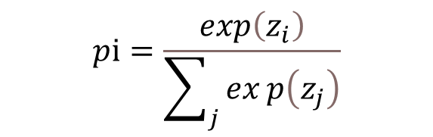
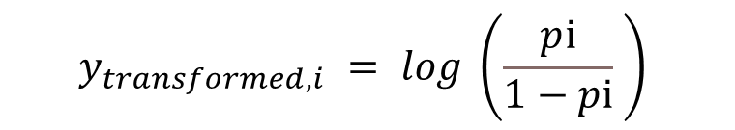
HINTON-BASED DISTILLATION (1/3)
Response-Based Online Distillation
As a baseline, we choose a decision tree student model as a reference. For comparison matters with PD ESTIMATION MODELS, we train a logistic regression using Hinton-Based distillation. Practically, we train a linear regression on teacher soft prediction. However, to constraint values to lie between 0 and 1, we apply the following transformation on teacher soft predictions before training:
$$y_{transformed, i} = log \left(\frac{pⅈ}{1−pⅈ} \right)$$
$$pⅈ=\frac{\exp\left(z_{i}\right)}{\sum_{j}{exp\left(z_{j}\right)}}$$
Where $pi$is teacher’s soft prediction for the class i, $z_{i}$ are teacher’s logits and $y_{transformed, i}$ is the new target ranging on the negative real numbers line.
$ℒ_{kD}=\sum_{\left(x_{t},y_{t}\right)}{\left[αℒ_{CE}\left(f_{s},x_{t},y_{t}\right)\right.}+(1−α{) ℒ}_{kL}\left(f_{s}, f_{T},x_{t}\right)$]
Formula 1. Response-Based Knowledge Distillation Loss, $α$ is the contribution of the loss comparing to ground truth labels.
Figure 7. Hinton-Based Distillation Framework

Slide 12
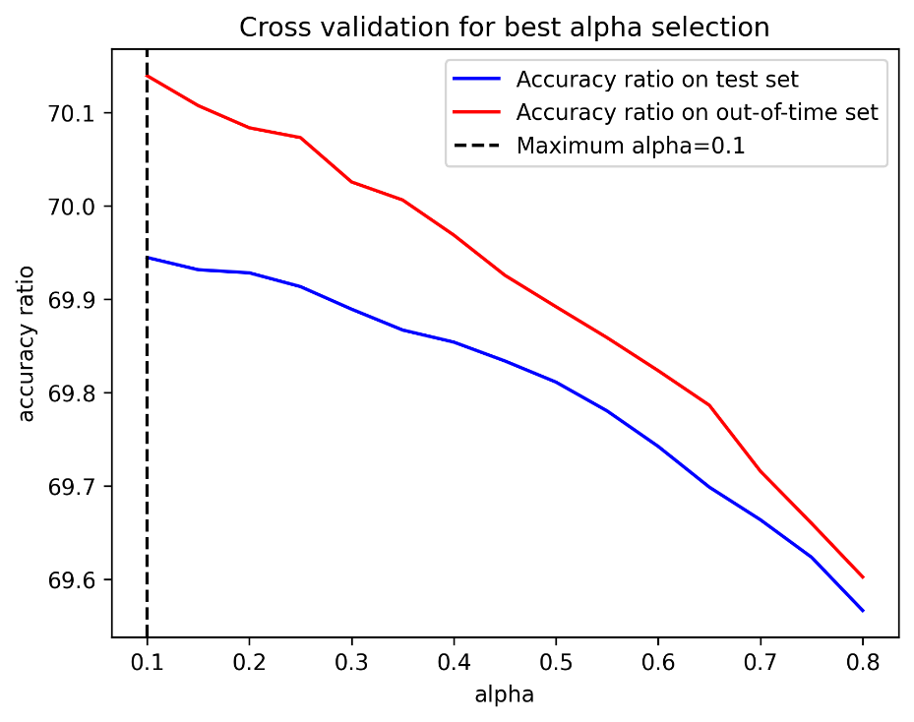
HINTON-BASED DISTILLATION (2/3)
Response-Based Online Distillation
Figure 8. Cross-validation for best $α$ selection
Models | Role | AR TRAIN | AR TEST | AR OOT
PD estimation models models | Baseline | 65,4% | 66,2% | 66,4%
LightGBM with regularization | Teacher | 70.87 % | 67.41 % | 71.44 %
Decision Tree Distilled | Student | 68.5 % | 64.48 % | 70.16 %
Logistic Regression Distilled | Student | 68.03 % | 63.94 % | 70.13 %
Remarkable Improvement on out-of-time set
Table 4. Hinton-Based Students’ Performance

Slide 13
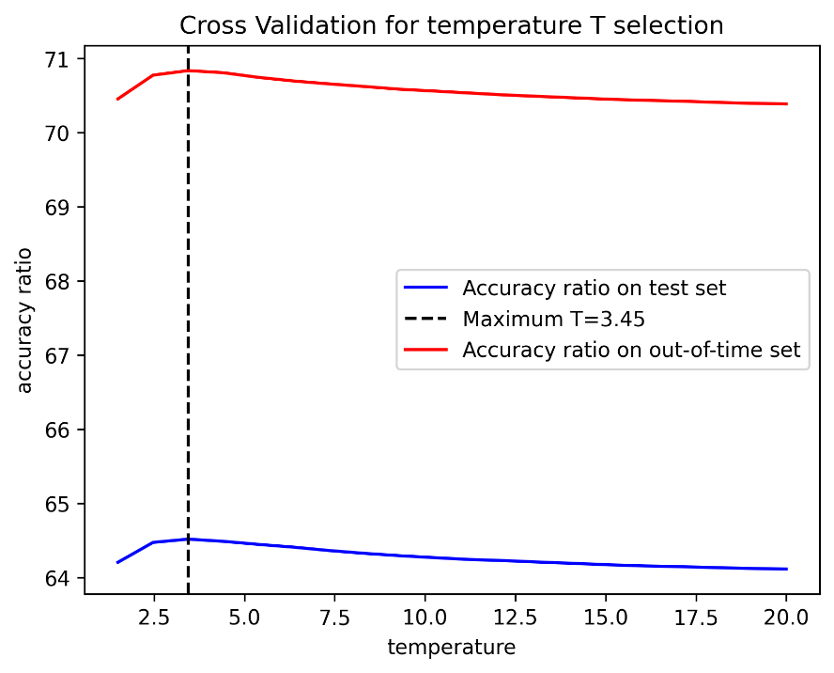
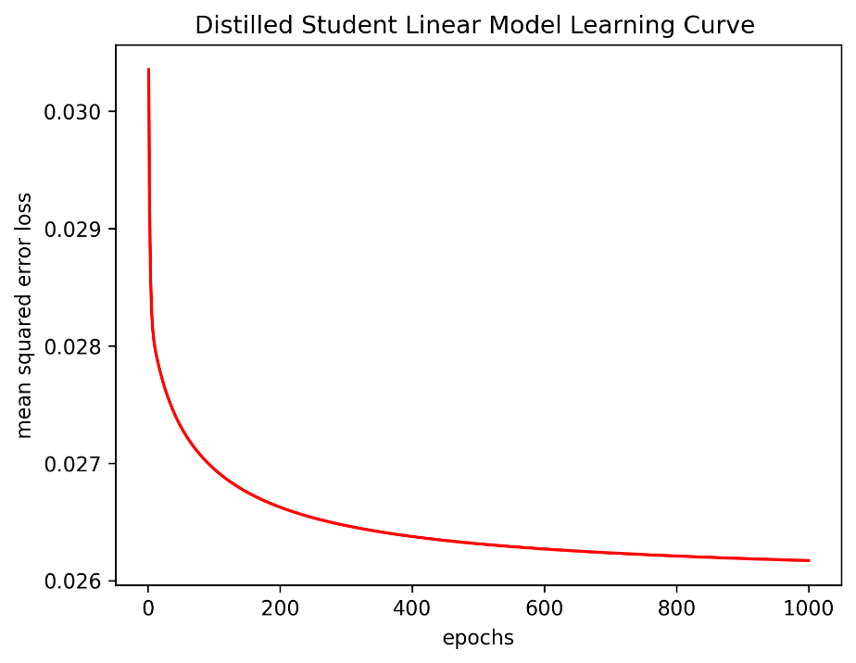

HINTON-BASED DISTILLATION (3/3)
Response-Based Online Distillation with Temperature T
Figure 9. Cross-validation for best $T$ selection, T = 3.45 corresponds to the best accuracy ratio on the test set.
Figure 10. learning curve’s training convergence with T = 3.45
Models | Role | AR TRAIN | AR TEST | AR OOT
PD ESTIMATION MODELS | Baseline | 65,4% | 66,2% | 66,4%
LightGBM with regularization | Teacher | 70.87 % | 67.41 % | 71.44 %
Logistic Regression Distilled | Student | 68.03 % | 63.94 % | 70.13 %
Logistic Regression Distilled with Temperature | Student | 68.63 % | 64.51 % | 70.83 %
$$pⅈ=\frac{\exp\left(\frac{z_{i}}{T}\right)}{\sum_{j}{exp\left(\frac{z_{j}}{T}\right)}}$$
Formula 2. Teacher’s softened predictions with temperature T
Table 5. LightGBM Students’ Performance. Softening teacher’s outputs enhance student performance.

Slide 14
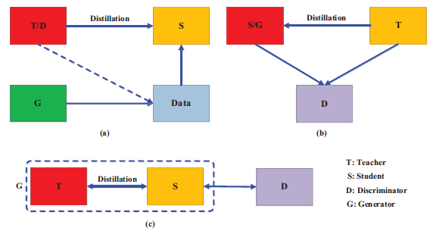
Adversarial Knowledge Distillation Framework (1/10)
Exploring Generative Knowledge Distillation Technique to Improve the Student AR TEST
So far, we have achieved great result on the OOT set (AR OOT). However, the student accuracy ratio on the test set (AR TEST) still need to be improved. To achieve that, we will be performing an advanced distillation framework called adversarial knowledge distillation.
An effective framework to enhance the power of student learning via the teacher knowledge distillation using GANs. This framework tackles the problem arising from the small capacity of the student and difficulties to mimic accurately the teacher which lead to the performance gap.
S : student
G: generator
T: teacher
D: discriminator
Figure 11. In addition to Hinton-based distillation process, the student will generate new data based on its internal feature distribution corrected each time by the discriminator which is trained to discriminate real and fake feature distribution.
* More details about adversarial knowledge distillation framework is provided in Appendix

Slide 15
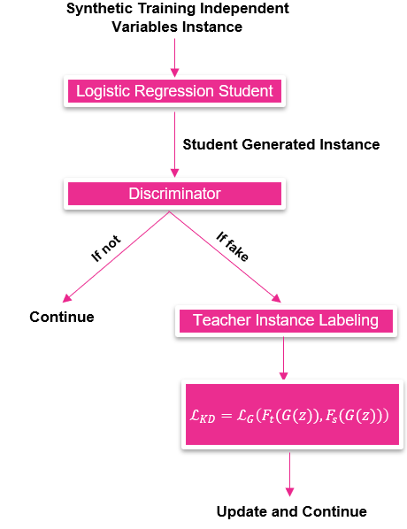
Adversarial Knowledge Distillation Framework (2/10)
Exploring Generative Knowledge Distillation Technique to Improve the Student AR TEST
This method will help the student to generalize well. In our case, student’s parameters are updated only when the generated instance is labeled as fake which help update parameters only when the model is mistaken and adjust its data distribution.
PD ESTIMATION MODELS PERFORMANCE
Stop Condition AR TEST >= 66.2 %
Figure 12. Adversarial Knowledge Distillation Training Framework Performed on PD ESTIMATION MODELS. In this case, the generator is also the student which is a logistic regression. The teacher is the LightGBM used in the Hinton-based Framework.

Slide 16
Adversarial Knowledge Distillation Framework (3/10)
Discriminator Training Framework
The discriminator is trained to predict either a generated instance from the generator (the student in our case) is real or fake. In other words, it’s used to predict if a generated instance follows the real data distribution or not.
To train it, we generate fake instances including the dependent variable then, we label it as fake (1). In the other hand, we label real training instances as real (0). Then we concatenate and shuffle fake and real instances and finally train the discriminator model.
Fake data should be a random noise, containing examples that are both far away from real data distribution and near to real data distribution to challenge the discriminator model training.
Fake Data
Train
Discriminator
Real Data
Figure 13. Discriminator Training Flow
How to Construct Fake Data ?

Slide 17
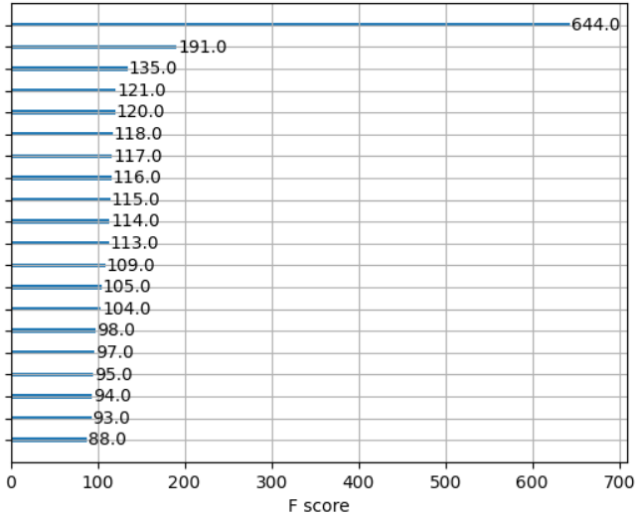
Adversarial Knowledge Distillation Framework (4/10)
Discriminator Training Framework - Fake Data Construction
Figure 14. Preliminary discriminator (LightGBM) training. The continuous variable has almost 6 times more importance comparing to other features.
The discriminator relies the most on the continuous feature to make its prediction. How to construct fake examples of this variable ?

Slide 18
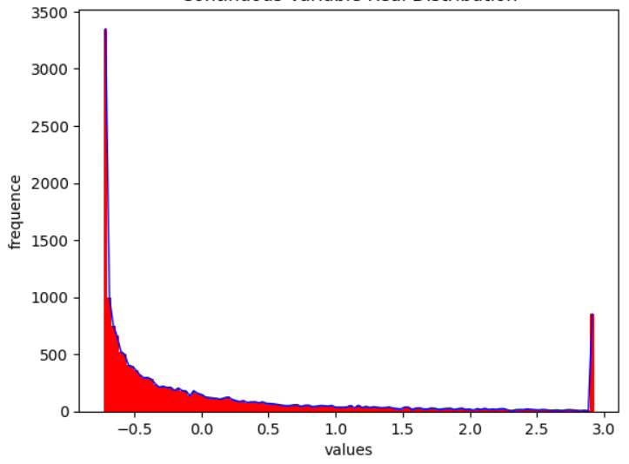
Adversarial Knowledge Distillation Framework (5/10)
Discriminator Training Framework - Constructing Fake Instances of the Continuous Feature
Test/Train Noise Distribution Similarity
Trivial Training Examples
Figure 15. Discriminator Training Main Challenges
Figure 16. Continuous feature distribution in the training data
Trivial training examples: Since the continuous variable has a very consequent weight on discriminator’s decision, constructing fake example of it following regular distributions can be a trivial task for the discriminator during test. It is easy for the model to discriminate fake and real data during test since he overfit on fake data distribution. This led to biased performance metrics in test set.
Test/Train Noise Distribution Similarity: Noise distribution used during training must be different (not strictly) from noise distribution during test especially for the continuous variable to avoid biased metrics.
Construction of fake continuous variable from multiple distributions (either estimate the real distribution of data via kernel density method to make it hard for the discriminator or use a mix of multiple random distribution)
During test phase, we will not use the same fake continuous variable distribution.
Solution

Slide 19
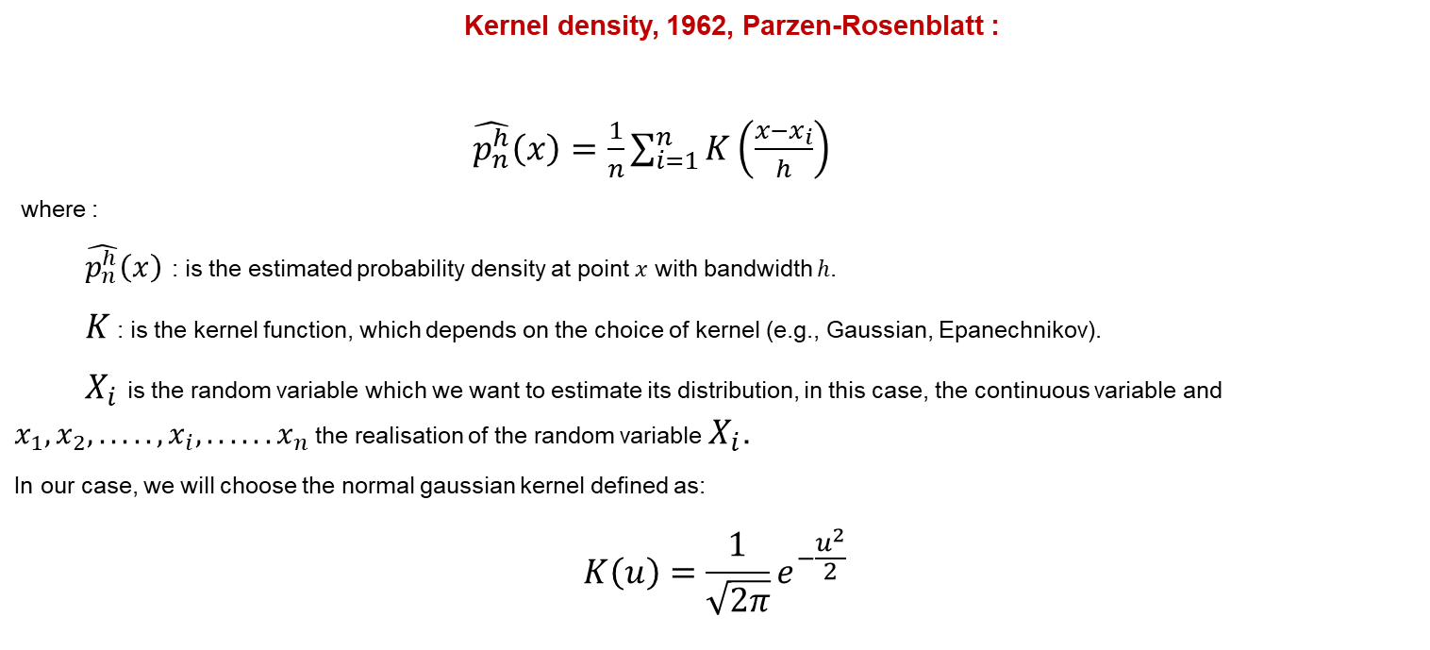
Adversarial Knowledge Distillation Framework (6/10)
Constructing Fake Instances of the Continuous Feature – Continuous Variable Distribution Approximation
Constructing an estimator of the probability distribution of the continuous variable with non-parametric estimation using kernel density
The idea is to sample the noise from a close estimation of the probability distribution of the continuous variable to avoid triviality and challenge the discriminator since the continuous variable is the most important feature of the model. The model relies mainly on it to make its prediction.
Kernel density, 1962, Parzen-Rosenblatt :
$\hat{p_{n}^{h}}\left(x\right)=\frac{1}{n}\sum_{i=1}^{n}{K\left(\frac{x−x_{i}}{h}\right)}$
where :
$\hat{p_{n}^{h}}\left(x\right)$ : is the estimated probability density at point $x$ with bandwidth ℎ.
$K$ : is the kernel function, which depends on the choice of kernel (e.g., Gaussian, Epanechnikov).
$X_{i}$ is the random variable which we want to estimate its distribution, in this case, the continuous variable and $x_{1}, x_{2}, ....., x_{i},...... x_{n}$ the realisation of the random variable $X_{i}$.
In our case, we will choose the normal gaussian kernel defined as:
$$K\left(u\right)=\frac{1}{\sqrt{2π}}e^{−\frac{u^{2}}{2}}$$

Slide 20
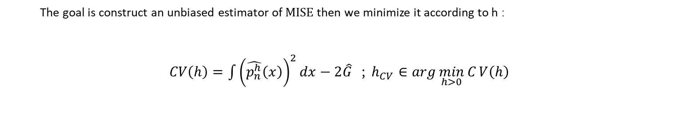
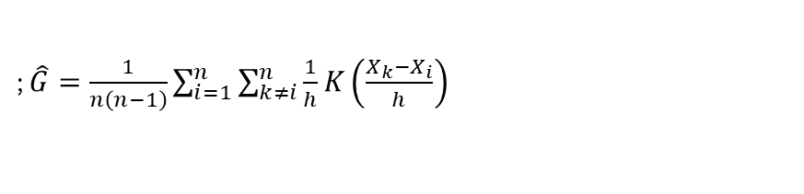
Adversarial Knowledge Distillation Framework (7/10)
Constructing Fake Instances of the Continuous Feature - Cross Validation to determine the optimal bandwidth h
Don’t depend on h
The goal is construct an unbiased estimator of $\text{MISE}$then we minimize it according to h :
$CV\left(h\right)=\int{{\left(\hat{p_{n}^{h}}\left(x\right)\right)}^{2}}dx−2\hat{G}$ ; $h_{CV}∈\arg{\min_{h>0}{C}}V\left(h\right)$
; $\hat{G}=\frac{1}{n\left(n−1\right)}\sum_{i=1}^{n}{\sum_{k≠i}^{n}{\frac{1}{h}}K\left(\frac{X_{k}−X_{i}}{h}\right)}$
Computing is done using Trapezoidal Method and data
Computing is done from data
1. Full demonstration is provided in Appendix

Slide 21
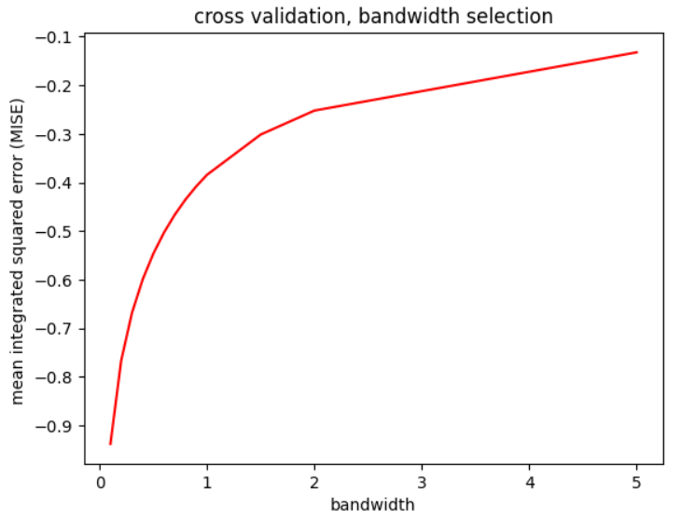
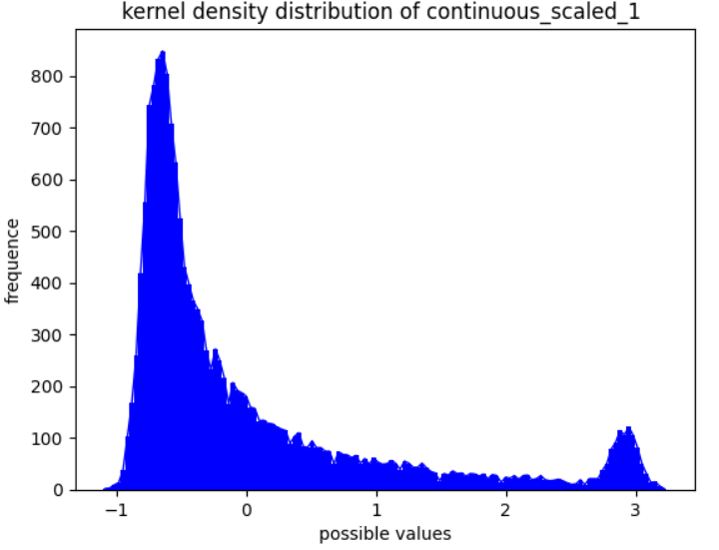
Adversarial Knowledge Distillation Framework (8/10)
Constructing Fake Instances of the Continuous Feature - Cross Validation to determine the optimal bandwidth h
Figure 19. Continuous variable distribution in the training data
Figure 17. Cross validation to select the best bandwidth h
Figure 18. Continuous variable’s distribution using Kernel Density
Approximation with h = 0.1

Slide 22
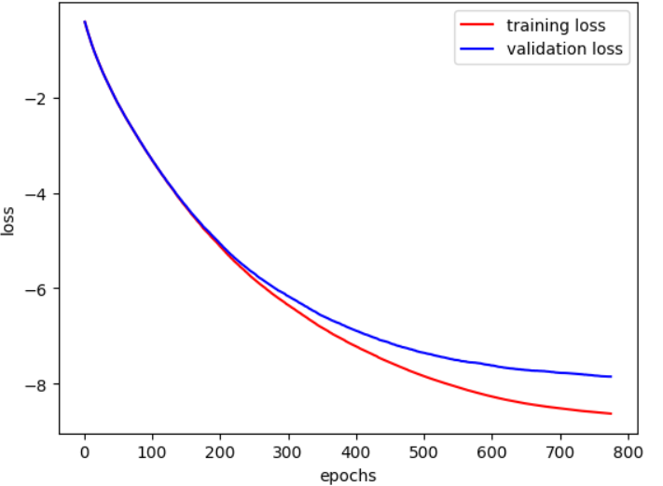
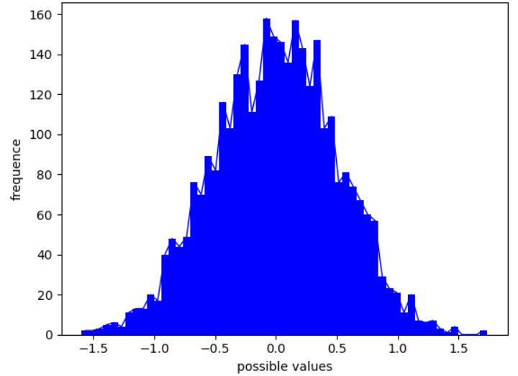
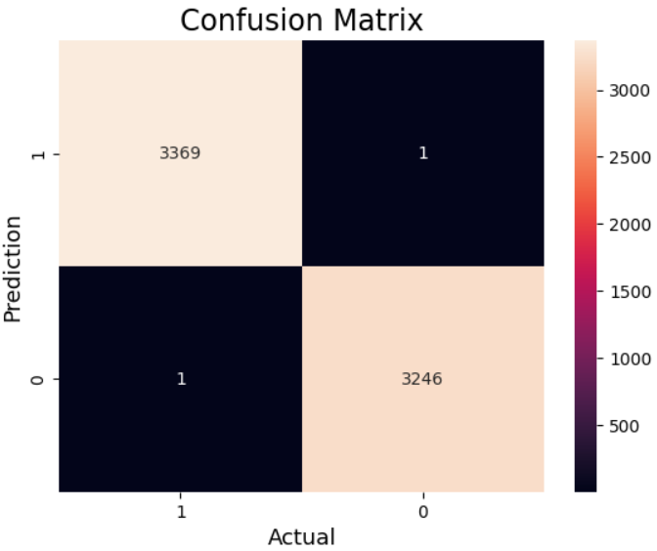
Adversarial Knowledge Distillation Framework (9/10)
Discriminator Training
Figure 21. Discriminator (LightGBM) Learning Curve
Figure 20. Noise Distribution of Continuous Variable During Test
Figure 22. Confusion Matrix of the LightGBM Discriminator

Slide 23
Adversarial Knowledge Distillation Framework (10/10)
Framework Results
Models | Role | AR TRAIN | AR TEST | AR OOT
PD ESTIMATION MODELS | Baseline | 65,4% | 66,2% | 66,4%
LightGBM with regularization | Teacher | 70.87 % | 67.41 % | 71.44 %
Logistic Regression trained with Hinton-Based distillation | Student | 68.63 % | 64.51 % | 70.83 %
Logistic Regression trained with Hinton-Based + Adversarial Knowledge Distillation | Student | 68.99% | 66.2% | 72.14%
Table 6. Students’ Performance using Adversarial Distillation Framework

Slide 24
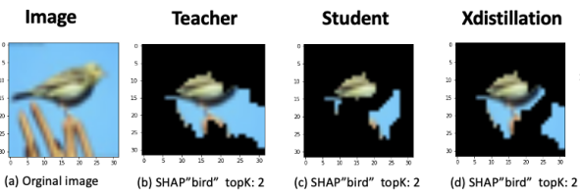
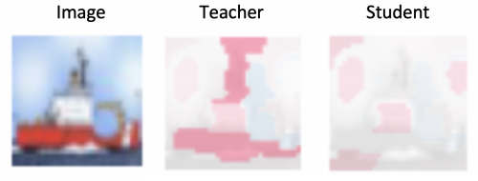
Xdistillation Framework (1/7)
Exploring Explainability Distillation (XD) Technique to Improve the Student AR TEST
Teacher explanation are important features driving a specific prediction. However, traditional distillation doesn’t distill explanation and thus, student predictions are not driven by the same features due to explanation inconsistency between the teacher and the student.
Alharbi and al., 2021 have proposed a novel framework to distill explanation in addition to dark knowledge called XDistillation (XD). The framework has outperformed all traditional distillation methods.
BEFORE
AFTER
XD
Fig 23. Inconsistency between teacher and student explanation
Fig 24. The overlapping explanation area of teacher, KD and XD.
* More details about XDistillation framework is provided in Appendix

Slide 25
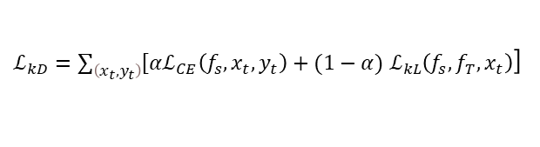
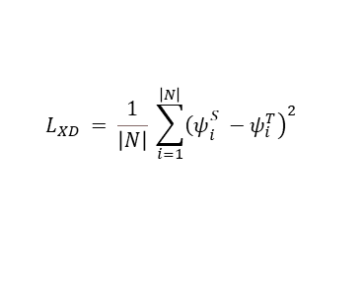
Xdistillation Framework (2/7)
Exploring Explainability Distillation (XD) Technique to Improve the Student AR TEST
.
Logits
Teacher
$ℒ_{kD}=\sum_{\left(x_{t},y_{t}\right)}{\left[αℒ_{CE}\left(f_{s},x_{t},y_{t}\right)\right.}+(1−α{) ℒ}_{kL}\left(f_{s}, f_{T},x_{t}\right)$]
Global SHAP Values*
Training Data
XDistillation Loss
Hinton-Based Distillation Loss
Global SHAP Values
$$L_{XD} = \frac{1}{\left|N\right|} \sum_{i=1}^{\left|N\right|}{{\left.{\left(ψ\right.}_{i}^{S} −ψ_{i}^{T}\right)}^{2} }$$
Student
Logits
Fig 25. XDistillation Framework Used to Enhance performance
* Corresponds to the absolute mean of local SHAP values across training instances

Slide 26
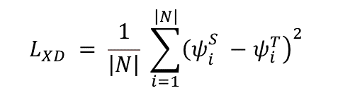
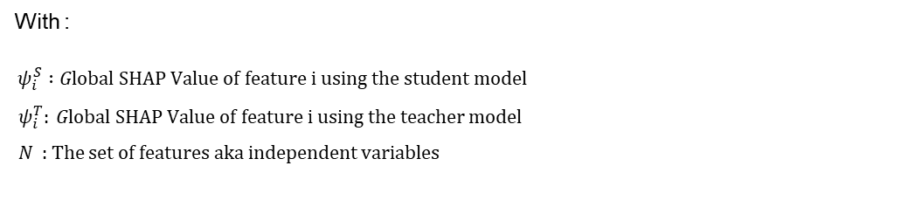
Xdistillation Framework (3/7)
Student’s Global SHAP Values Expression as a Function of Logistic Regression Parameters – Approximation
In our case, the expression of Xdistillation loss (or the optimization objective) can be expressed as the following:
$$L_{XD} = \frac{1}{\left|N\right|} \sum_{i=1}^{\left|N\right|}{{\left.{\left(ψ\right.}_{i}^{S} −ψ_{i}^{T}\right)}^{2} }$$
With :
$ψ_{i}^{S} :Global SHAP Value of feature i using the student model$
$ψ_{i}^{T}: Global SHAP Value of feature i using the teacher model$
$N$ : The set of features aka independent variables
To update our student’s (Logistic Regression) parameters ${ β}_{i}$. $ψ_{i}^{S}$ must be expressed as a function of ${ β}_{i}$ in order to perform gradient descent. However, calculating the theorical expression of ${ ψ}_{i}^{S}$ as a function of logistic regression parameters is not straightforward.
.

Slide 27
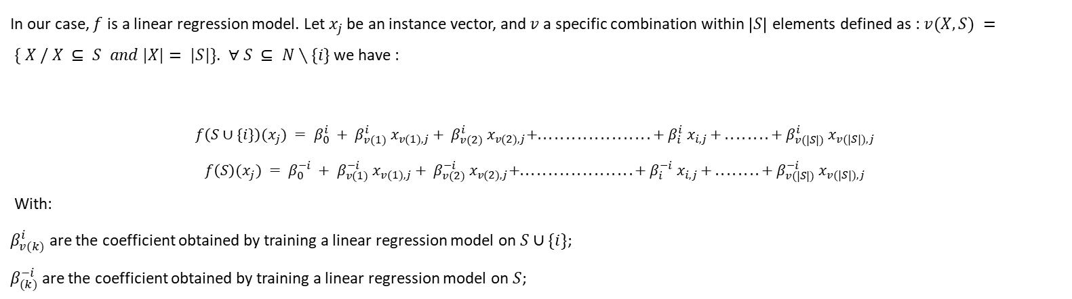
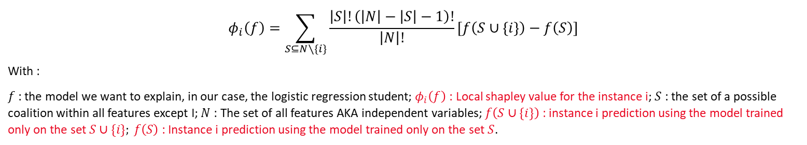
Xdistillation Framework (4/7)
Student’s Global SHAP Values Expression as a Function of Logistic Regression Parameters – Approximation
The SHAP values kernel explainer can be expressed as:
$$φ_{i}\left(f\right)=\sum_{S⊆N∖\{i\}}{\frac{\left|S\right|!\left(\left|N\right|−\left|S\right|−1\right)!}{\left|N\right|!}}\left[f\left(S∪\{i\}\right)−f\left(S\right)\right]$$
With :
$f$: the model we want to explain, in our case, the logistic regression student; $φ_{i}\left(f\right)$ : Local shapley value for the instance i; $S$ : the set of a possible coalition within all features except I; $N$ : The set of all features AKA independent variables; $f\left(S∪\{i\}\right)$ : instance i prediction using the model trained only on the set $S∪\{i\}; f\left(S\right)$: Instance i prediction using the model trained only on the set $S$.
In our case, $f$ is a linear regression model. Let $x_{j}$ be an instance vector, and $v$ a specific combination within $\left|S\right|$ elements defined as : $v(X, S) = \{ X / X ⊆ S and |X|= |S|\}$. $∀ S ⊆ N∖\{i\}$ we have :
$$f\left(S∪\{i\}\right)(x_{j}) = β_{0}^{i} + β_{v(1)}^{i} x_{v(1),j}+ β_{v(2)}^{i} x_{v(2),j}+....................+ β_{i}^{i} x_{i,j }+ ........ + β_{v(|S|)}^{i} x_{v(|S|),j }$$
$$f\left(S\right)(x_{j}) = β_{0}^{−i} + β_{v(1)}^{−i} x_{v(1),j}+ β_{v(2)}^{−i} x_{v(2),j}+....................+ β_{i}^{−i} x_{i,j }+ ........ + β_{v(|S|)}^{−i} x_{v(|S|),j }$$
With:
$β_{v(k)}^{i}$ are the coefficient obtained by training a linear regression model on $S∪\{i\}$;
$β_{(k)}^{−i}$ are the coefficient obtained by training a linear regression model on $S$;
.

Slide 28
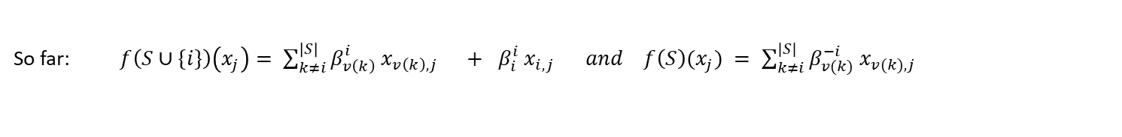

Xdistillation Framework (4/7)
Student’s Global SHAP Values Expression as a Function of Logistic Regression Parameters – Approximation
So far: $f\left(S∪\{i\}\right)\left(x_{j}\right)= \sum_{k≠i}^{\left|S\right|}{β_{v\left(k\right)}^{i} x_{v\left(k\right),j} + β_{i}^{i} x_{i,j } } and f\left(S\right)(x_{j}) = \sum_{k≠i}^{|S|}{β_{v(k)}^{−i} x_{v(k),j} }$
So the Shapley value of a feature i is simplified as :
$$φ_{i}\left(f\right)=\sum_{S⊆N∖\{i\}}{\frac{\left|S\right|!\left(\left|N\right|−\left|S\right|−1\right)!}{\left|N\right|!}}\left[\sum_{k≠i}^{|S|}{{( β}_{v(k)}^{i}−β_{v(k)}^{−i}) x_{v(k),j } + β_{i}^{i} x_{i,j } }\right]$$
Let’s denote:
$$C_{1}^{S} = \frac{\left|S\right|!\left(\left|N\right|−\left|S\right|−1\right)!}{\left|N\right|!} ; C_{2,i}^{S}= \sum_{k≠i}^{|S|}{{( β}_{v(k)}^{i}− β_{v(k)}^{−i}) x_{v(k),j } }$$
In this case, we have:
$$φ_{i}\left(f\right)=\sum_{S⊆N∖\{i\}}{C_{1}^{S}}\left[C_{2,i}^{S} + β_{i}^{i} x_{i,j }\right]$$
.
Approximation : Let’s assume that $C_{2,i}^{S} = 0$, which means that $β_{v(k)}^{i}= β_{v(k)}^{−i}$. Training $f$ for each coalition $S$ is cumbersome. Instead, we attribute the value zero to features excluded $S$.

Slide 29
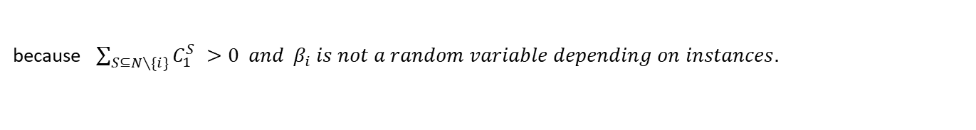
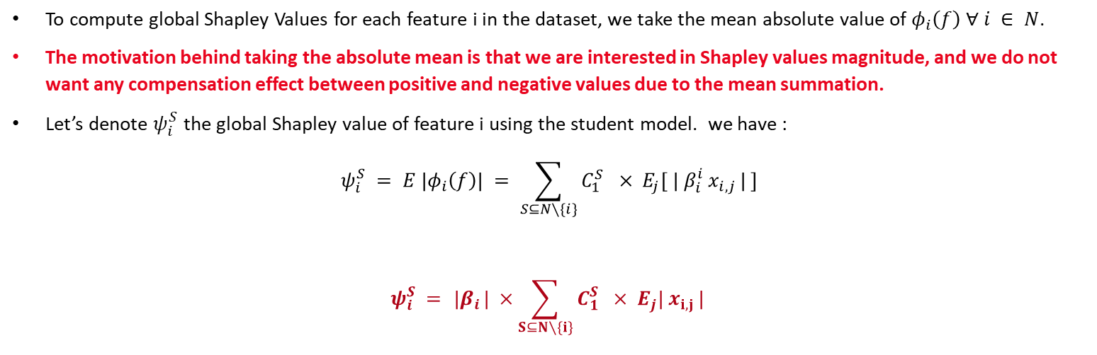
Xdistillation Framework (4/7)
Student’s Global SHAP Values Expression as a Function of Logistic Regression Parameters – Approximation
To compute global Shapley Values for each feature i in the dataset, we take the mean absolute value of $φ_{i}\left(f\right)$ $∀ i ∈ N$.
The motivation behind taking the absolute mean is that we are interested in Shapley values magnitude, and we do not want any compensation effect between positive and negative values due to the mean summation.
Let’s denote $ψ_{i}^{S}$ the global Shapley value of feature i using the student model. we have :
$$ψ_{i}^{S} = E |φ_{i}\left(f\right)| = \sum_{S⊆N∖\{i\}}{C_{1}^{S}} × E_{j}[{ | β}_{i}^{i} x_{i,j }| ]$$
$$ψ_{i}^{S} = { |β}_{i}| ×\sum_{S⊆N∖\{i\}}{C_{1}^{S}} × E_{j}| x_{i,j }|$$
because $\sum_{S⊆N∖\{i\}}{C_{1}^{S}} >0 and { β}_{i} is not a random variable depending on instances.$
.
Now that we have the expression of the Shapley values of our linear model $f$ expressed using the coefficients ${ β}_{i}$ . we can calculate the gradient of XDistillation loss between student’s Shapley values and teacher Shapley values

Slide 30
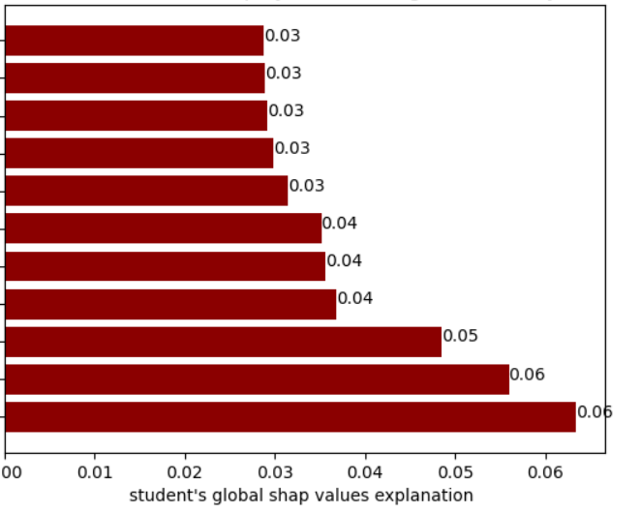
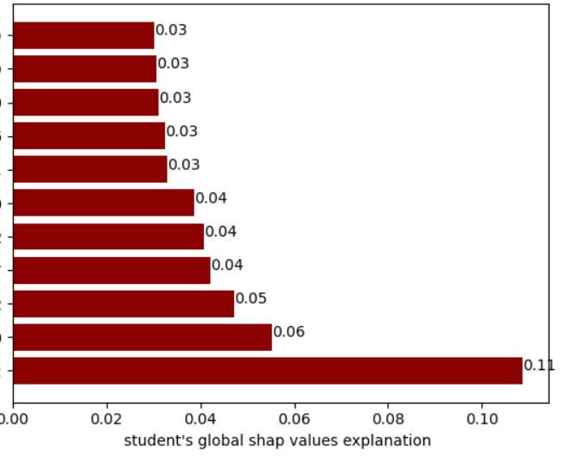
Xdistillation Framework (5/7)
Student’s Global SHAP Values Expression as a Function of Logistic Regression Parameters – Approximation
Figure 26. Student’s global Shapley values using SHAP library in Python
Figure 27. Student’s global Shapley values using kernel explainer approximation
.

Slide 31
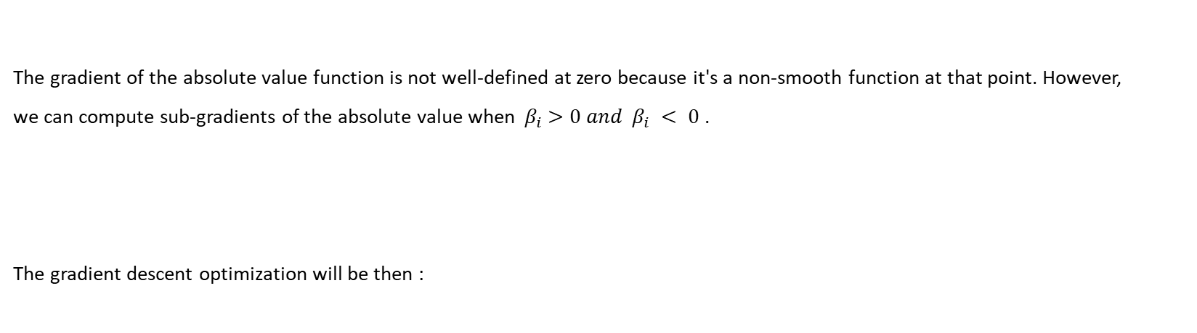
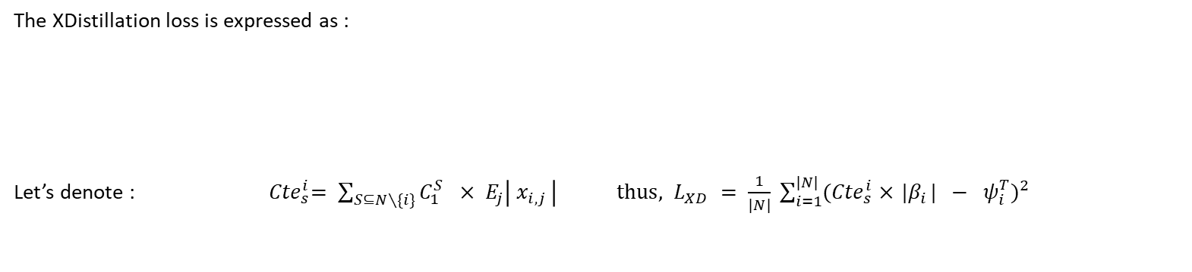
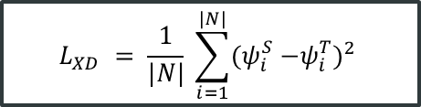
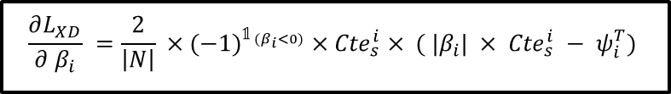

Xdistillation Framework (6/7)
Student’s Global SHAP Values Expression as a Function of Logistic Regression Parameters – Approximation
The XDistillation loss is expressed as :
Let’s denote : ${ Cte}_{s}^{i}= \sum_{S⊆N∖\{i\}}{C_{1}^{S}} × E_{j}\left| x_{i,j }\right| thus, L_{XD} = \frac{1}{|N|} \sum_{i=1}^{|N|}{{{(Cte}_{s}^{i} ×{ |β}_{i}| − ψ_{i}^{T})}^{2} }$
$$L_{XD} = \frac{1}{|N|} \sum_{i=1}^{|N|}{{{(ψ}_{i}^{S} −ψ_{i}^{T})}^{2} }$$
The gradient of the absolute value function is not well-defined at zero because it's a non-smooth function at that point. However,
we can compute sub-gradients of the absolute value when ${ β}_{i} >0 and { β}_{i} < 0$ .
The gradient descent optimization will be then :
$$\frac{∂L_{XD}}{∂{ β}_{i}} =\frac{2}{\left|N\right|} ×{(−1)}^{𝟙_{{ (β}_{i}<0)}} ×{Cte}_{s}^{i}× ({ |β}_{i}| × {Cte}_{s}^{i} − ψ_{i}^{T})$$
.
$$β_{i, m+1} = β_{i, m }− α× \frac{∂L_{XD}}{∂{ β}_{i}}$$

Slide 32
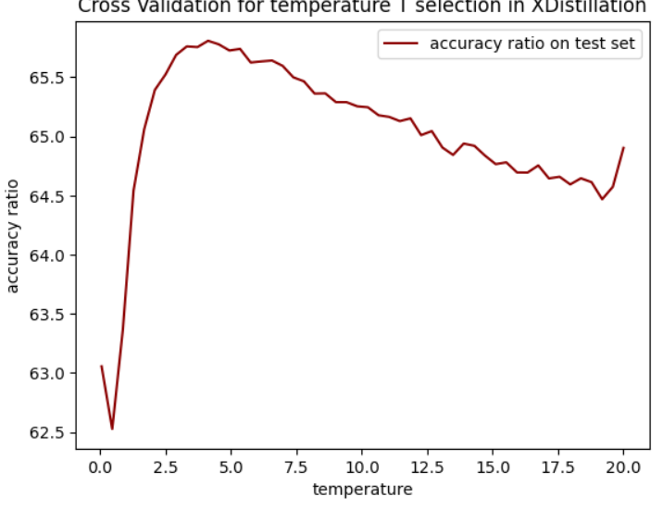
Xdistillation Framework (7/7)
Xdistillation Framework Results
Models | Role | AR TRAIN | AR TEST | AR OOT
PD ESTIMATION MODELS | Baseline | 65,4% | 66,2% | 66,4%
LightGBM | Teacher | 70.87 % | 67.41 % | 71.44 %
Logistic Regression trained with Hinton-Based distillation with temperature | Student | 68.63 % | 64.51 % | 70.83 %
Logistic Regression trained with Hinton-Based with temperature + Xdistillation | Student | 70.09% | 66.01% | 72.78%
Table 7. XDistillation framework performance comparing with Hinton-Based distillation with temperature
Figure 28 . Cross validation for best temperature T selection in Xdistillation. Here T = 4.12
.

Slide 33
PD ESTIMATION MODELS’ DISTILLATION TAKEAWAY
WRAP-UP
Sparsity
Due to one-hot encoding
Dependency between instances
We suppose that obligors in different dates are independent, which is not true. This frauds logistic regression instances independency hypothesis.
Unbalanced Dataset
In the dataset, there is only 4% of default (1) examples.
Figure 29. Main problems in training data. This explains also why achieving better performance on the test set was challenging.

Slide 34
3. DISTILLATION on LENDING CLUB DATASET
Teacher Training – Feed-Forward Neural Networks
Teacher Training – XGBOOST
Student Distillation Training – Feed-Forward Neural Network

Slide 35
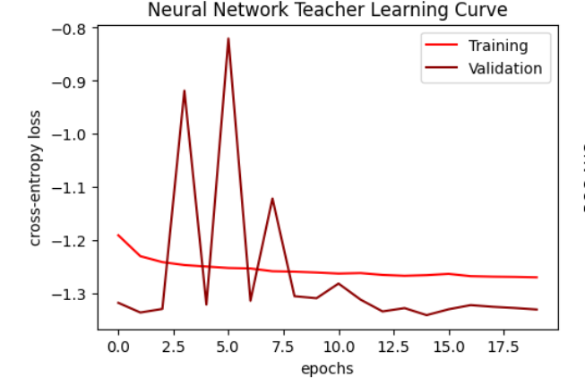
DISTILLATION TESTS ON LENDING CLUB dataset (1/3)
Teacher Training – Feed-Forward Neural Networks
Metric | Train | Test
ROC AUC | 0.909 | 0.906
F1-Score | 0.6281 | 0.6249
Table 8. Teacher Performance
Figure 31. Neural Network Teacher’s Learning Curve

Slide 36
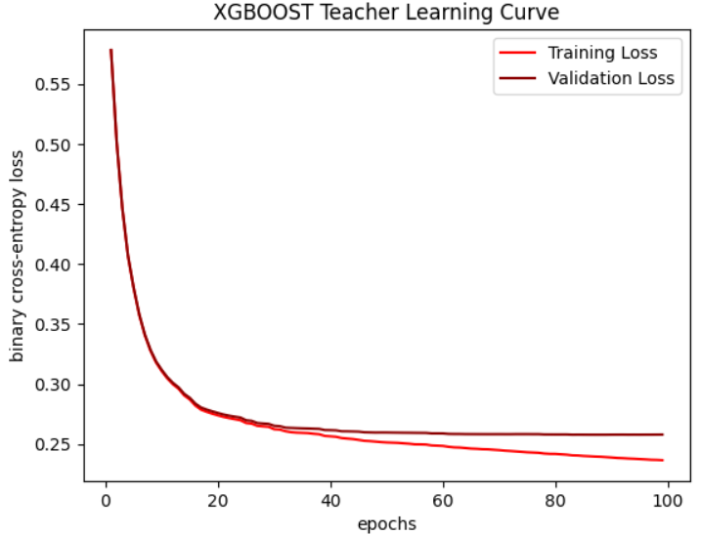
DISTILLATION TESTS ON LENDING CLUB dataset (2/3)
Teacher Training – XGBOOST
Metric | Train | Test
ROC AUC | 0.909 | 0.906
F1-Score | 0.651 | 0.627
Table 9. XGBOOST Teacher Performance
Figure 32. XGBOOST Teacher’s Learning Curve

Slide 37
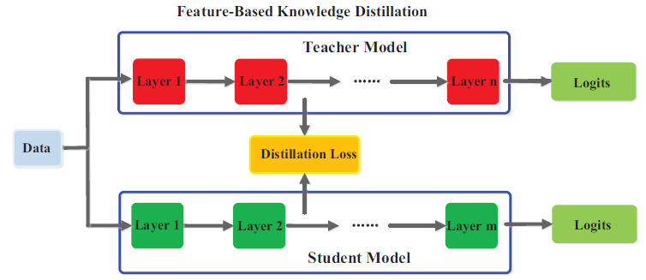
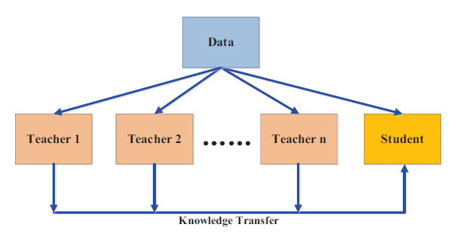
DISTILLATION TESTS ON LENDING CLUB dataset (3/3)
Student Training – Feed-Forward Neural Network
Figure 33. The generic feature-based knowledge distillation
Figure 34. Multi-teacher Distillation Framework’s Illustration
Models | ROC AUC TRAIN | ROC AUC TEST
FFNN Teacher | 90.96% | 90.65%
XGBOOST Teacher | 92,86% | 90.73%
Student with Hinton-Based Distillation | 71.45% | 71.48%
Student with Multi-Teacher Distillation | 88.95% | 88.97%
Student with Feature-Based Distillation | 71.44% | 71.47%
Selected Teacher
Compression Ratio = 51.41
Model | #parameters
Teacher | 58,357
Student | 1,135
Table 10. Student’s performance
Table 11. Student’s Performance using different Distillation Frameworks

Slide 38
REFERENCES
Craven and al., 1995: Extracting Tree-Structured Representations of Trained Networks
Caruana and al.,2006: model compression
Hinton and al.,2015: Distilling the Knowledge in a Neural Network
Han and al., 2015: Learning both Weights and Connections for Efficient
Hoffman and al., 2015: Cross Modal Distillation for Supervision Transfer
Zagoruyko and al., 2017: Attention Transfer
Huang and al., 2017: Knowledge Distill via Neuron Selectivity Transfer
Caruana and al., 2017: Interpretable & Explorable Approximations of Black Box Models
Yim and al, 2017: A Gift from Knowledge Distillation: Fast Optimization, Network Minimization and Transfer Learning
Burda, Edwards and al., 2018: Exploration by Random Network Distillation
Caruana and al., 2018: Distill-and-Compare: Auditing Black-Box Models Using Transparent Model Distillation
Liu and al., 2018: Improving the Interpretability of Deep Neural Networks with Knowledge Distillation
Asadulaev and al., 2019: Interpretable Few-Shot Learning via Linear Distillation
Bastani and al., 2019: Interpreting Blackbox Models via Model Extraction
Zhang and al, 2021: Adversarial co-distillation learning for image recognition

Slide 39
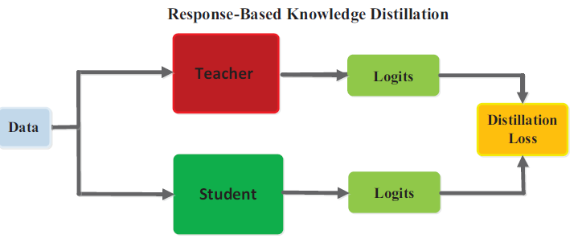


APPENDIX (1/6)
Response-Based Knowledge
The classical framework for knowledge distillation. The student tries to mimic as good as possible the output predictions of the teacher model in a response-based manner. Practically, we use logits (Neurons outputs before SoftMax) because they contain dark knowledge which is the deep knowledge learnt by the teacher.
Fig 4. The specific architecture of the benchmark knowledge distillation. The student model can learn to mimic teacher’s predictions and also ground truth labels.
Pros | Knowledge | Limits
Easy-to-use, straight-forward Fast, efficient | Predictions of the teacher model Dark knowledge embedded in soft targets or in logits (Hinton and al, 2015, Caruana and al, 2014). | Limited to supervised learning Relies on the final output fails to address intermediate-level supervision
Formula 1. Hinton Loss for Response-Based KD, Source, Hinton and al, 2015
Table 2. Response-based distillation investigation
Formula 2. Hinton Soft-Targets for Response-Based KD, Source, Hinton and al, 2015; very high T values correspond approximately to matching logits.

Slide 40

APPENDIX (2/6)
Feature-Based Knowledge Distillation
Feature maps
Feature aggregation
Fig 5. The generic feature-based knowledge distillation.
Fig 6. Some types of feature-based knowledge
Pros | Knowledge | Limits
Learn multiple levels of feature representation. | 1) Feature representation, hint layers (Romero et al., 2015) 2)Parameter distribution, multi-layer group (Liu et al., 2019c) 3)Feature Maps, hint layers (Chen et al., 2021) | Effectively choose the hint layers from the teacher model and the guided layers from the student model with optimum training complexity is questionable.
Table 3. Feature-based distillation investigation
.

Slide 41
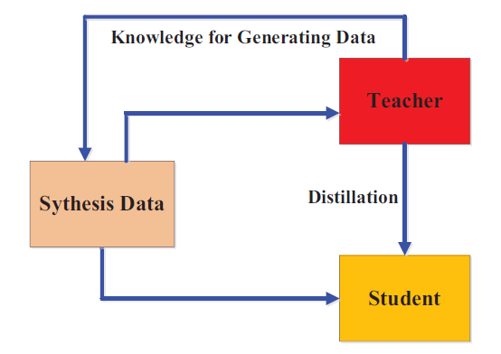
APPENDIX (3/6)
SOME DISTILLATION FRAMEWORKS
1. Multi-teacher Distillation
2. Data-Free Distillation
Problem | Usage example | Pros
1) Bias coming from one the teacher 2) Lack of knowledge using one teacher | 2 teachers, one transfers response-based knowledge and the other transfers feature-based knowledge (Chen et al. 2019b). | Provide richer knowledge to the student Straightforward
Problem | Usage example | Pros
1) Unavailable data arising from privacy, legality, security and confidentiality | Data is generated from the feature representations from the pre-trained teacher model and used to train the student model in addition to traditional distillation. | Powerful, Uses GAN Straightforward
Table 6. Multi-teacher Distillation Framework’s detailed explanation.
Table 7. Data-Free Distillation Framework’s detailed explanation.

Slide 42
Adversarial Knowledge Distillation
APPENDIX (4/6)
An effective framework to enhance the power of student learning via the teacher knowledge distillation using GAN. This framework tackles two main problems;1) Difficulty for the teacher to learn the true data distribution (lack of data, unrepresentative data, small model, etc.); 2) Small capacity of the student and difficulties to mimic accurately the teacher ( Capacity gap, Unreliable teachers)
Scheme | Explanation
(a) | A generator is trained on true data distribution. Generated Data go then through teacher discrimination based on its proper data distribution. Student learns then teacher knowledge from 2 sources; 1) classical distillation process, 2) through generated data embedding teacher’s internal feature representation.
(b) | A discriminator is trained on teacher’s feature distribution. In addition to traditional distillation process, the student will generate new data based on its internal feature distribution corrected each time by the discriminator. The generated data is not used for training.
(c) | A discriminator is trained on true data distribution and corrects feature distribution of generators which are the student and teacher in an online setting.
Fig 10. The different categories of the main adversarial distillation methods.
Table 8. Adversarial Knowledge Distillation Framework’s detailed explanation.

Slide 43


APPENDIX (5/6)
Cross Validation to determine the optimal bandwidth h
Don’t depend on h
The goal is construct an unbiased estimator of $\text{MISE}$then we minimize it according to h. Let’s denote :
$$τ(h)=E\left[\int{{\left(\hat{p_{n}^{h}}\left(x\right)\right)}^{2}}dx\right]−2× E\left[\int{\hat{p_{n}^{h}}\left(x\right)p\left(x\right)}dx\right]$$
$\int{{\left(\hat{p_{n}^{h}}\left(x\right)\right)}^{2}}dx$ is an unbiased estimator of $E\left[\int{{\left(\hat{p_{n}^{h}}\left(x\right)\right)}^{2}}dx\right]$
Let’s construct an unbiased estimator for the second term:
$$E_{p}\left[\int{\hat{p_{n}^{h}}\left(x\right)p\left(x\right)}dx\right]=E_{p}\left[\int{\left(\frac{1}{n}\sum_{i=1}^{n}{\frac{1}{h}}K\left(\frac{X_{i}−x}{h}\right)\right)p\left(x\right)} dx\right]$$

Slide 44


APPENDIX (6/6)
Cross Validation to determine the optimal bandwidth h
$$E_{p}\left[\int{\hat{p_{n}^{h}}\left(x\right)p\left(x\right)}dx\right]=\int{E_{p}\left[\frac{1}{h}K\left(\frac{X_{i}−x}{h}\right)\right]p\left(x\right)} dx=\int{\int{\frac{1}{h}}K\left(\frac{y−x}{h}\right)p\left(y\right)p\left(x\right)} dy dx$$
Using the leave one-out estimator leave-one out of p, let’s denote : $\hat{G}=\frac{1}{n\left(n−1\right)}\sum_{i=1}^{n}{\sum_{k≠i}^{n}{\frac{1}{h}}K\left(\frac{X_{k}−X_{i}}{h}\right)}$
Which give this passing the expectancy $E_{p}\left(\hat{G}\right)=\frac{1}{n\left(n−1\right)}\sum_{k≠i}{\frac{1}{h}}E_{p}\left[K\left(\frac{X_{k}−X_{i}}{h}\right)\right]$
The joint distribution of ${(X}_{k}, X_{i})$ is $p\left(y\right)p\left(x\right)$ (Independent Variables), Thus,
$E_{p}\left(\hat{G}\right)=\frac{1}{h}\int{\int{K\left(\frac{y−x}{h}\right)p\left(y\right)p\left(x\right)}} dy dx$
So $\hat{G}$ is an unbiased estimator of $E\left[\int{\hat{p_{n}^{h}}\left(x\right)p\left(x\right)}dx\right]$. Thus, the cross-validation objective is defined as:
$CV\left(h\right)=\int{{\left(\hat{p_{n}^{h}}\left(x\right)\right)}^{2}}dx−2\hat{G}$ ; $h_{CV}∈\arg{\min_{h>0}{C}}V\left(h\right)$
Trapezoidal method
From data

